Slide 1
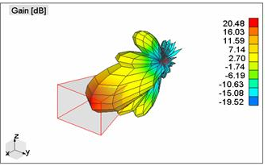

Adjacent Transmitter/Receiver Near Field Effects
TX
RX
LNA2
LNA1
Horn Antenna Radiation Pattern
LNA2 still recovering from saturation when receive mode activates
3D Figure: http://www.wipl-d.com/applications.php?cont=antenna-design/aperture-antennas
SCOTT NICEWONGER

Slide 2
RF Isolation Method: Physical Dimensioning
Increase distance to nearest receiver will:
Mitigate bleed-over signal
Change phase center locations
Re-calculate phase slope
Modify signal processing logic
TX
d
RF Absorber (Optional)
RX
LNA2
LNA1
SCOTT NICEWONGER

Slide 3
Isolation Method 2: Receive Mode Switch (Design 1)
SCOTT NICEWONGER

Slide 4
Isolation Method 2: Receive Mode Switch (Design 2)
SCOTT NICEWONGER

Slide 5








Indoor Phase Distortion
Room Top-View
RF Absorber
Floor
TX
Reflector
Receiver
$$Σ$$
$$Target φ_{1}$$
$$Multipath φ_{2}$$
RX
$$Multipath φ_{3}$$
…
$$Multipath φ_{4}$$
…
$$Multipath φ_{m}$$
$$NearField Effects (Bleedover) φ_{b}$$
$$System Noise φ_{N}$$
SCOTT NICEWONGER

